Slide 1

30 Years of MySQL: Reflections on the Past, Present, and Future
Vini (Vinicius) Grippa Lead Database Engineer

Slide 2
30 years ago
Back to 1995
Notes:
Iphone was released 18 years ago 2007

Slide 3
How was the IT world back to 1995
RISC vs CISC
Motorola was a chip manufacturer
Apple Macintosh PowerPC
Windows 95
PlayStation (America release)
Yahoo! Search
Postgres95
MySQL first internal release released by MySQL AB
Notes:
Google would be release in 1996 as a Project named backrub at Stanford University - Larry Page and Sergey Brin
Yahoo was also in Stanford University
Reduced Instruction Set Computer vs Complex Instruction Set Computer

Slide 4
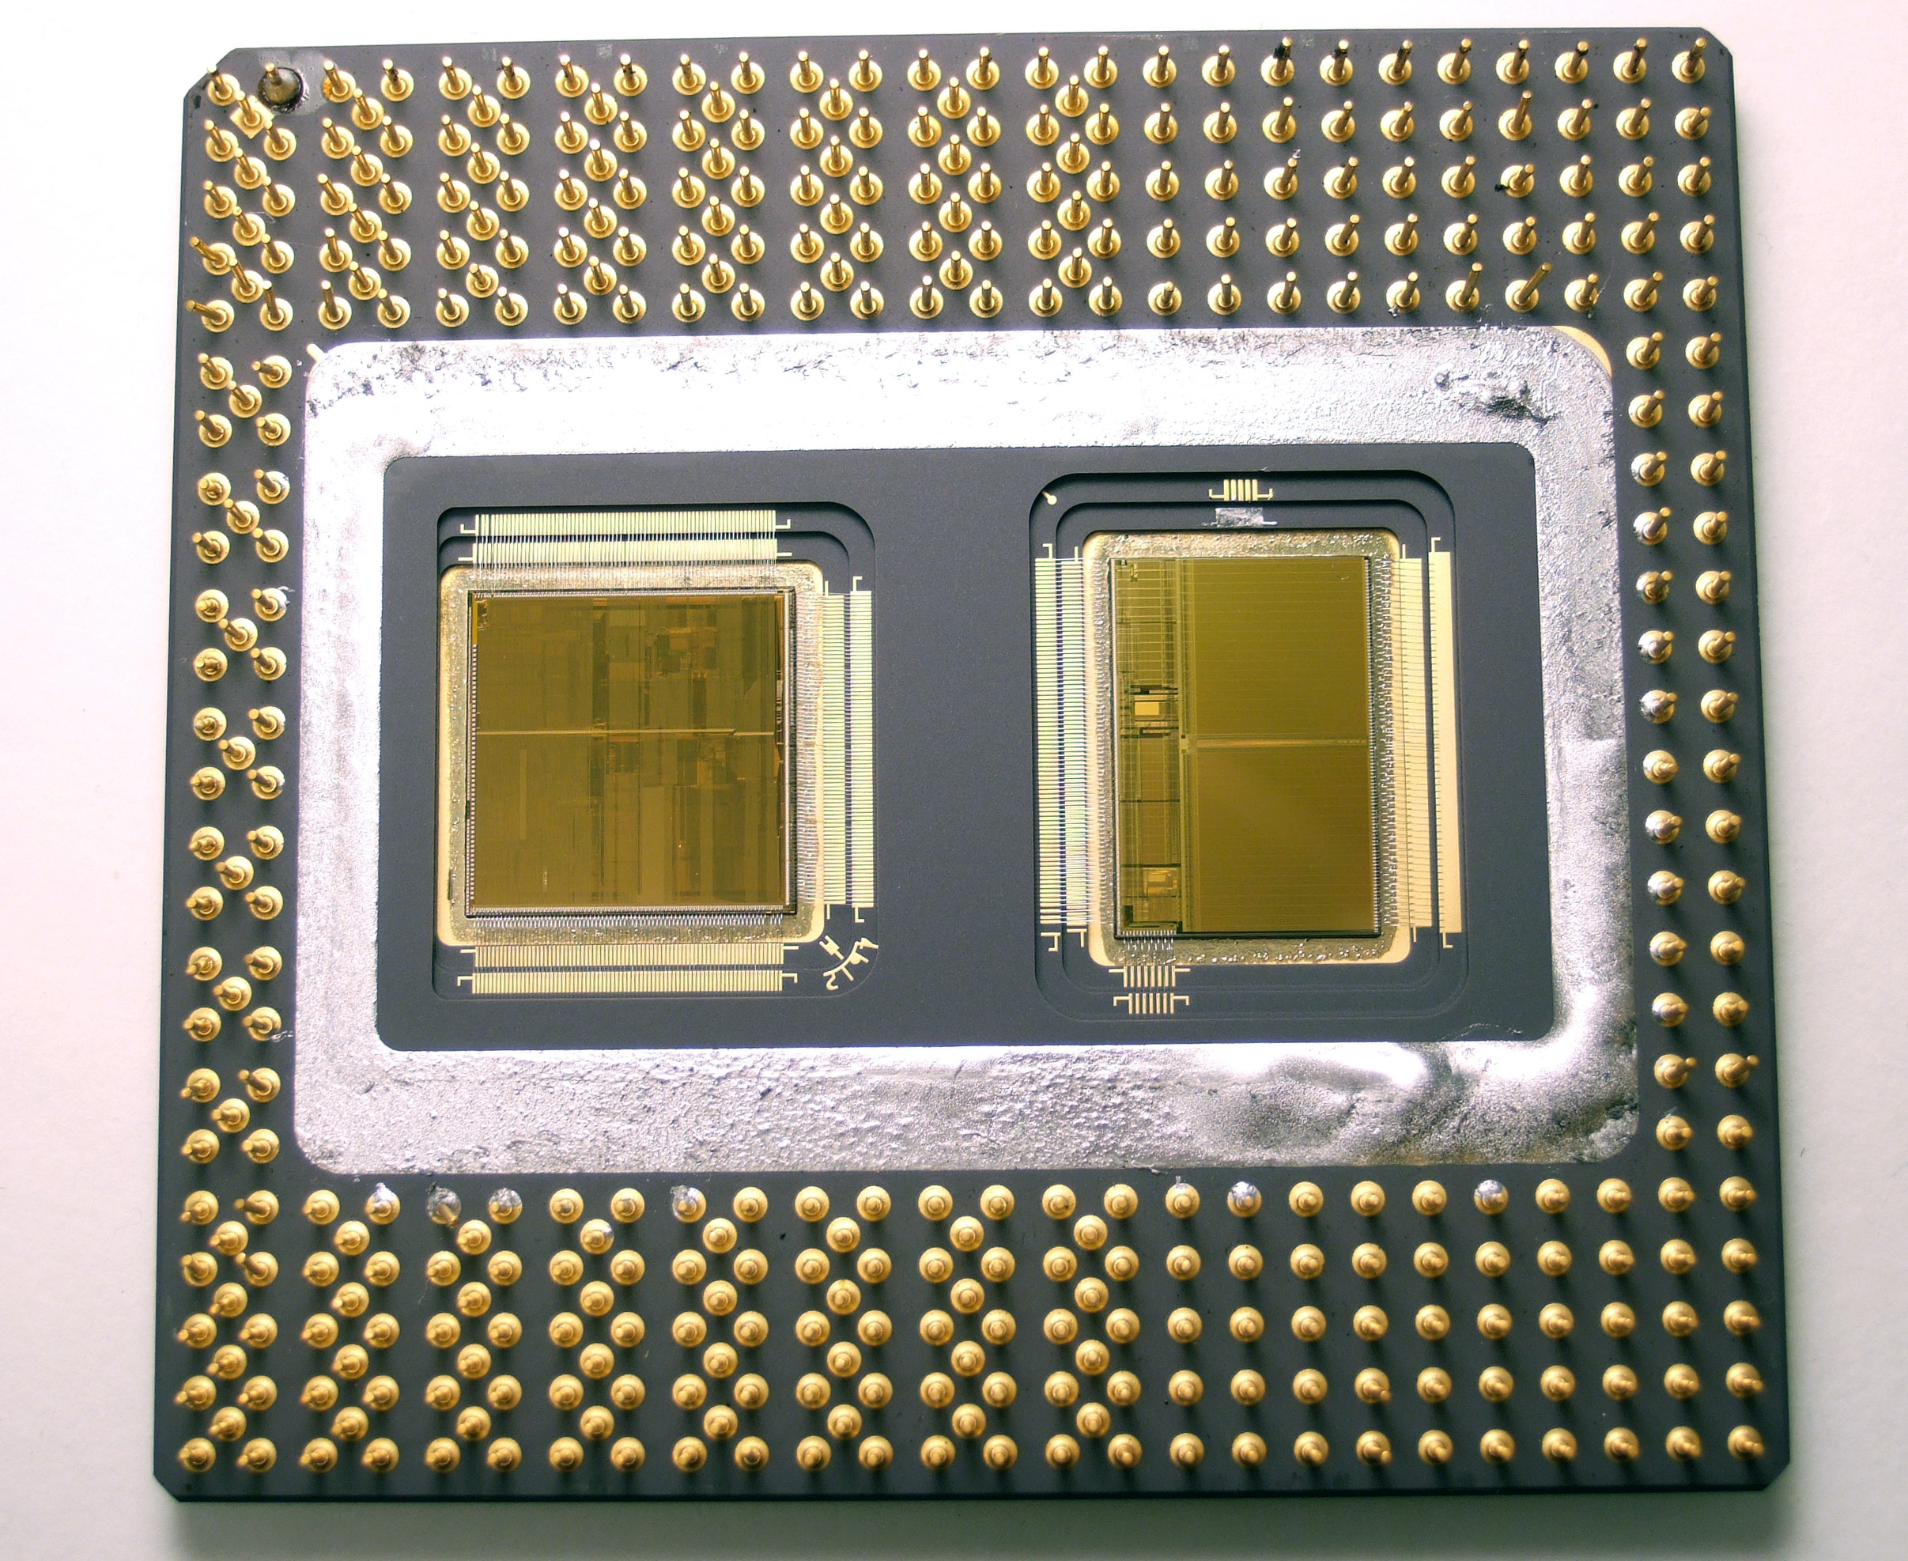
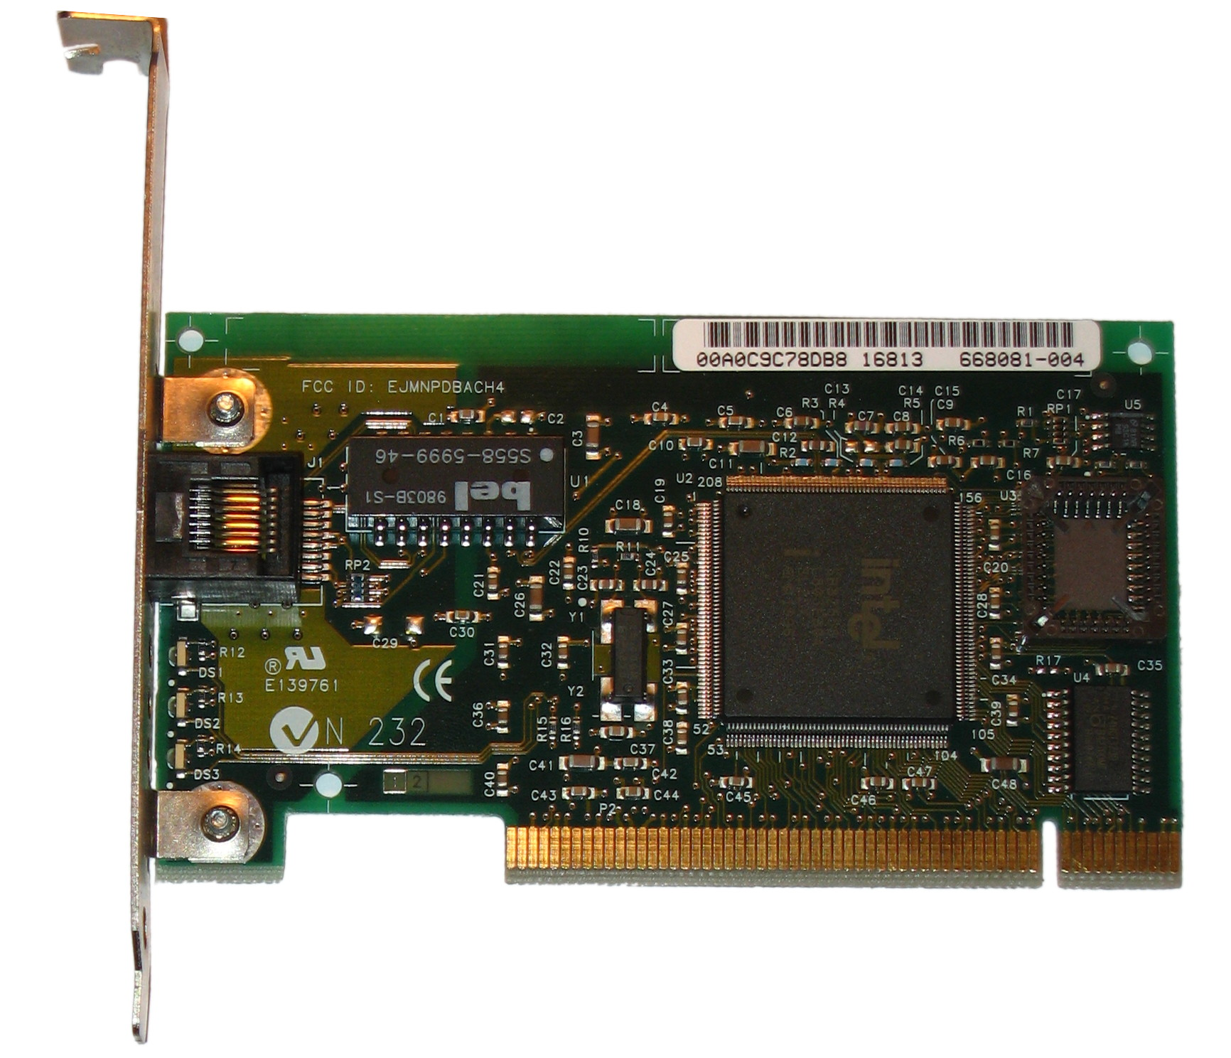
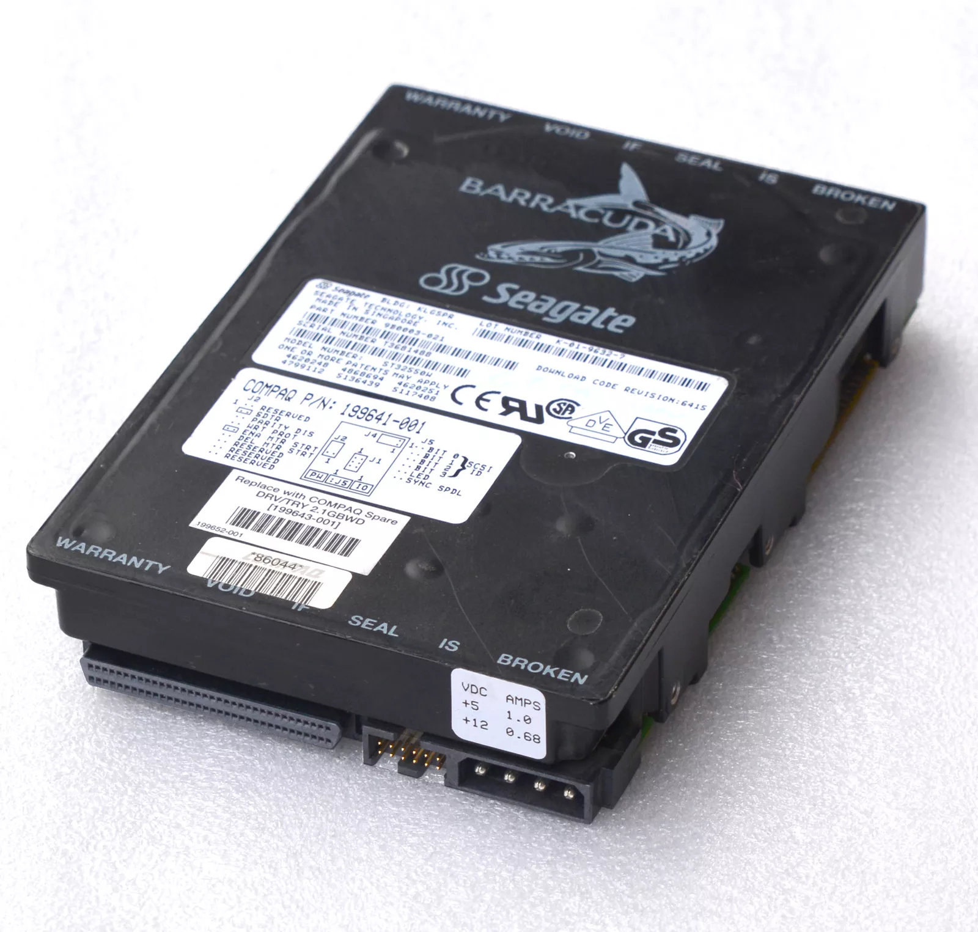
How was the IT world back to 1995
Intel Pentium Pro, 150-200 MHZ, 500-300 nm, 1 CPU
64GB Ram
100Base-TX network (100 Mbit/s)
2GB HD with SCSI-2 (innodb_flush_neighbors)
Notes:
https://en.wikipedia.org/wiki/Pentium_Pro
https://www.intel.com/content/www/us/en/products/sku/49953/intel-pentium-pro-processor-200-mhz-512k-cache-66-mhz-fsb/specifications.html
https://en.wikipedia.org/wiki/Random-access_memory#DRAM
https://en.wikipedia.org/wiki/Seagate_Barracuda
The first commercial DDR (double data rate) SDRAM chip was released by Samsung in 1998
Internet at home starts with 500mbits/s

Slide 5

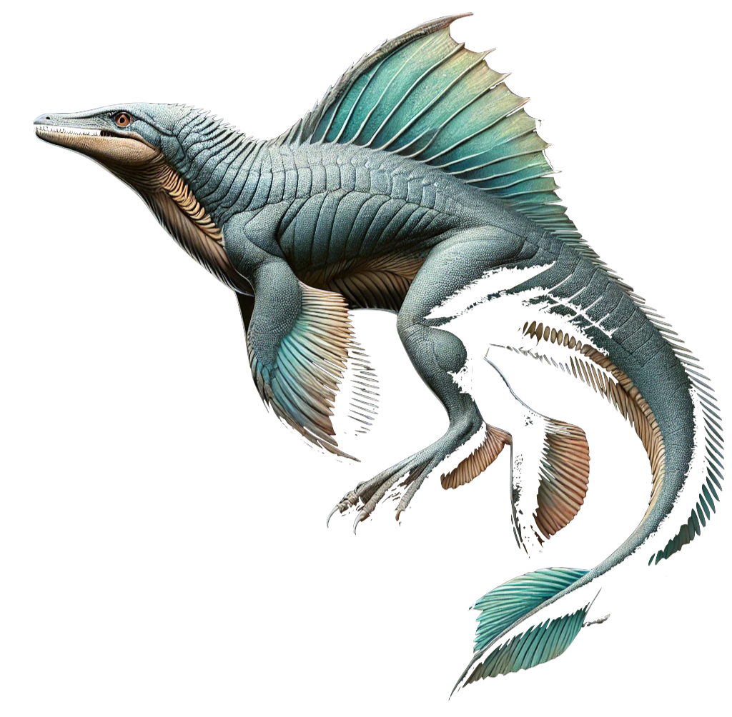
Evolution of the Dolphin
1995: First internal MySQL release (Michael "Monty" Widenius);
Innobase is founded by Heikki Tuuri to develop InnoDB
1996: Version 3.19 released
2000: Innobase started collaboration with MySQL AB
2001: Version 3.23 production release.
2002: Version 4.0 beta released.
2003: Version 4.0 production release (unions added).
2004: Version 4.1 production release (R-trees, B-trees, subqueries, prepared statements).
1998: Release for Windows 95 and NT;
Version 3.21 production release;
Notes:
MongoDB is released at 2009
Oracle 11g released in 2007
MytSQL used MyISAM
ACID (atomicity, consistency, isolation, durability)

Slide 6



Evolution of the Dolphin
2004: Version 4.1 production release (R-trees, B-trees, subqueries, prepared statements).
2005: Version 5.0 production release (cursors, stored procedures, triggers, views, XA transactions);
Oracle acquires Innobase
2008:
Sun acquired MySQL AB; Version 5.1 production release (event scheduler, partitioning, plugin API, row-based replication, server log tables).
2006: Percona was founded by Vadim and Peter
AWS is Released
Notes:
MongoDB is released at 2009
Oracle 11g released in 2007
MySQL used MyISAM
ACID (atomicity, consistency, isolation, durability)
HW changes to multi cores
WordPress

Slide 7

Evolution of the Dolphin
Notes:
\

Slide 8


Evolution of the Dolphin
2010: Oracle acquired Sun Microsystems MariaDB forked by Michael “Monty” Widenius MySQL Server 5.5 released
2015: Version 5.7 released (native JSON data type support, replication improvements).
ProxySQL is released
2013: Version 5.6 released (query optimizer improvements, higher transactional throughput, NoSQL-style APIs, better performance monitoring).
2016: MySQL Group Replication Release
2014: Kubernetes Release
Notes:
http://dev.cs.ovgu.de/db/mysql/index.html

Slide 9



Evolution of the Dolphin
2018: Version 8.0 released (NoSQL Document Store, JSON enhancements, atomic DDL);
2024: MySQL 8.4 release
2023: MySQL HeatWave Oracle OCI PostgreSQL 16 released
2030: ???
2025:
2016: MySQL Group Replication Release
2022: ChatGPT release date
...
Notes:
http://dev.cs.ovgu.de/db/mysql/index.html

Slide 10

Testimonials
A remarkable moment for me was the very inspiring talk by Martin Mickos about how the database feature war is over and how MySQL will commoditize the database market and kick Oracle’s ass. It is an interesting memory as a historical “what-if” moment. What if Heikki had sold InnoDB to MySQL instead of Oracle at the time? What if MySQL had gone public and continued as an independent company instead of being snatched by Sun?
The future of MySQL is rather uncertain right now, as far too much depends on what Oracle decides to do. It seems Oracle has tilted the balance toward investing more in the commercial/cloud/Heatwave version of MySQL rather than the core open-source product.
With PostgreSQL having so much momentum, will this investment be enough to keep MySQL relevant over the next decade or not?
There is also uncertainty in the MariaDB space. With new owners, will they have the resources to invest in making it the best open-source MySQL alternative? I do not know.
My hope is that the broader MySQL community comes together, including, of course, Percona and major cloud vendors, which can pull in more resources than Oracle or MariaDB, to create a future for MySQL that is governed in the collective interest rather than in the interests of a single for-profit company.
Peter Zaitsev, founder of Percona
Notes:
http://dev.cs.ovgu.de/db/mysql/index.html

Slide 11

Testimonials
I had the opportunity to develop a new client-server protocol, which was later ported to vxWorks and installed on the first Mars Rover. Being a member of the NASA team that successfully landed that Rover on Mars remains one of the greatest achievements of my career.
As for MySQL, it has grown into such a feature platform over the years. There is a vast ecosystem of add-on products available, like HeatWave and RonDB.
Sinisa Milivojevic, developer at Oracle #2 employee
Notes:
http://dev.cs.ovgu.de/db/mysql/index.html

Slide 12


Testimonials
My favorite moment were the Percona Live events that happened in Santa Clara. Those were wonderful. I really enjoyed presenting at those events. Sessions and tutorials. The Community was very active, willing to travel and happy to meet all together at a single place. Plenty of remarkable experts with a single focus: MySQL! From 2013 to 2018., these were 5 years of technical content, friendship and fun.
About the future of MySQL, is a complicated questions. MySQL will never be the same as it was I guess. I've more of course, but I can't say publicly
Frederic Descamps, MySQL Evangelist
About the future of MySQL, is a complicated questions. MySQL will never be the same as it was I guess.
3:37
lefred
I've more of course, but I can't say publicly
About the future of MySQL, is a complicated questions. MySQL will never be the same as it was I guess.
3:37
lefred
I've more of course, but I can't say publicly
About the future of MySQL, is a complicated questions. MySQL will never be the same as it was I guess.
3:37
lefred
I've more of course, but I can't say publicly
Notes:
http://dev.cs.ovgu.de/db/mysql/index.html

Slide 13
Questions?

Slide 14


Slide 15
3.23
5.1
5.7
8.4
???

Slide 16
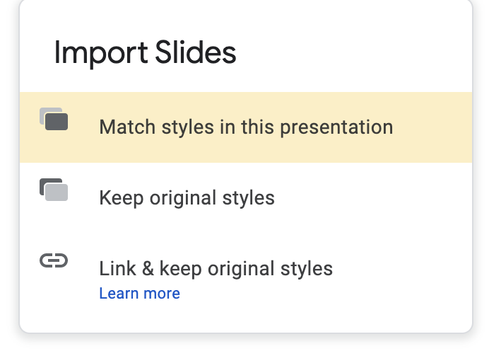
Importing slides from another slide deck
When importing another slide or slides to this presentation, please choose the option: Match styles in this presentation

Slide 17
Colour/Color Palette
#0e1a53
#5e6686
#ff7e1a
#ffc496
#f24500
#f9a98a
#1486ff
#93c7ff
#f0b336
#f8dca3
#30d1b2
#a0eadc
#a86fef
#d7bdf8
#697793
#bac0cd

Slide 18


Slide 19
Title here
Subtitle Poppins Medium Size 20
Subtitle Poppins Medium Size 20
Text - Poppins Normal size 18
Or
Poppins Normal size 18
Poppins Normal size 18
Poppins Normal size 18
Text - Poppins Normal size 18
Or
Poppins Normal size 18
Poppins Normal size 18
Poppins Normal size 18

Slide 20
Title here
Poppins Medium size 18
Poppins Normal size 18
Poppins Normal size 18
Poppins Normal size 18
Poppins Medium size 18
Poppins Normal size 18
Poppins Normal size 18
Poppins Normal size 18

Slide 21
Title here - Poppins Medium size 34 colour #oe1a53
Poppins Normal size 20 - colour #oe1a53

Slide 22
Title Here
Text - Poppins Normal size 18

Slide 23
Title Here
Text - Poppins Normal size 18

Slide 24
percona.com

Slide 25
Title Here
Text - Poppins Normal size 18
Text - Poppins Normal size 18

Slide 26
Section Cover
Subhead

Slide 27
Section Cover
Subhead

Slide 28
Section Cover
Subhead

Slide 29
Section Cover
Subhead

Slide 30
Section Cover
Subhead

Slide 31
Title Goes Here
Subtitle Goes Here

Slide 32
Extras

Slide 33
Poppins Bold Size 17
Poppins Bold Size 17
Poppins Normal 12
Poppins Normal 12
Poppins Bold 24
Poppins Normal 16
=
Poppins Bold Size 17
Poppins Bold Size 17
Poppins Normal 12
Poppins Normal 12

Slide 34
Title here -Poppins Medium Size 34
Subtitle - Poppins Semibold Size 18
Poppins Normal size 13
Poppins Normal size 13
Poppins Normal size 13
Poppins Normal size 13
Poppins Normal size 13
Poppins Normal size 13

Slide 35
Title
Title
Title
Subhead
Subhead
Subhead
Poppins Normal size 13
Poppins Normal size 13
Poppins Normal size 13
Poppins Normal size 13
Poppins Normal size 13
Poppins Normal size 13
Poppins Normal size 13
Poppins Normal size 13
Poppins Normal size 13
Poppins Normal size 13
Poppins Normal size 13
Poppins Normal size 13
Poppins Normal size 13
Poppins Normal size 13
Poppins Normal size 13
Poppins Normal size 13
Poppins Normal size 13
Poppins Normal size 13
Poppins Normal size 13
Poppins Normal size 13
Poppins Normal size 13
Poppins Normal size 13
Poppins Normal size 13
Poppins Normal size 13
Poppins Normal size 13
Poppins Normal size 13
Poppins Normal size 13

Slide 36
Title here
Subtitle
Poppins Normal size 13
Poppins Normal size 13
Poppins Normal size 13
Poppins Normal size 13
Poppins Normal size 13
Poppins Normal size 13

Slide 37
Timeline
January
February
March
Mid-March — Mid-April
April
Poppins Semi Bold Size 14
Poppins Semi Bold Size 14
Poppins Semi Bold Size 14
Poppins Semi Bold Size 14

Slide 38
Title here
Text
Goes Here
Text
Goes Here
Text
Goes Here
Call out Text
Call out Text
Call out Text
Text
Goes Here
Text
Goes Here
Call out Text
Call out Text

